Slide 1
SAP BTP Build Apps Training
Day 7
Anubhav Oberoy
www.AnubhavTrainings.com
Follow excellence with sheer passion

Slide 2

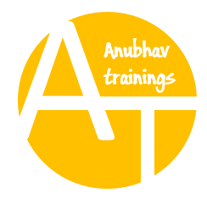
DISCLAIMER
The training content and delivery of this presentation is confidential, and cannot be recorded, or copied and distributed to any third party, without the written consent of Anubhav Trainings

Slide 3
Agenda – Day 7
01
Adding Search
02
Create Cart
03
BPA Introduction

Slide 4
Questions
If each variable is basically the same – they hold data – why use data variables? What are the 3 big advantages for using a data variable?
While all variables hold data, data variables in platforms like AppGyver, FlutterFlow, or similar low-code tools offer some unique advantages:
Three big advantages of data variables:
Automatic binding to data sources:
Data variables are connected directly to your backend or database (e.g., Firebase, REST API). They automatically fetch and update data.
Built-in lifecycle management:
They automatically refresh at certain events (e.g., on page load or when returning to the page), reducing the need for manual logic.
Simplifies UI binding:
You can easily bind a data variable to UI components like lists or text fields without manually parsing data.

Slide 5
Questions
2. What does the main logic for this page do? When is it executed?
The main logic on a page (often found in the "Page Mounted" or "Page Loaded" event) typically does things like:
Fetch data from a data source.
Initialize variables.
Set up UI components or display conditions.
It is executed when the page is first opened or loaded — essentially, it's the first set of actions triggered when the user navigates to that page.

Slide 6
Questions
3. What other types of events can I capture and create logic for?
You can capture and create logic for many types of events, such as:
Page events:
Page mounted (when the page loads)
Page focused (when the user navigates back to the page)
Component events:
Button pressed
Input changed
List item tapped
System events:
App launched
Device orientation changed
Keyboard opened/closed
Custom events:
Events you define and trigger through logic flows

Slide 7
Questions
4. What are the 2 ways you can navigate to a new page?
Two common ways to navigate to a new page are:
Using a "Navigate to Page" flow function (standard navigation)
You specify which page to go to, and it opens it.
Using a "Replace Page" flow function (replaces current page)
This navigates to a new page but removes the current page from history, so the user can’t go back with the back button.

Slide 8






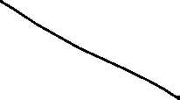


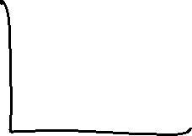










Slide 9













Slide 10

What We Did
Let’s Summarize

Slide 11

www.anubhavtrainings.com
Thank You
End of Day 7

Slide 12


We’re committed to empower you to be
#FutureReady
through powerful training solutions.
We build the workforce of the future.
250+
Corporate Clients
30,000+
Learners Trained
25000+
Learners Placed
FREE WEBINARS
Sign up for free webinars with industry experts every fortnight!
Enroll Now!
Contact us today!
https://anubhavtrainings.com

